Slide 1
RoboSpect Team G
STANDARDS AND REGULATIONS PRESENTATION Nov 6, 2023

Slide 2
Regulation 1
Code of Federal Regulations Title 49 Subtitle B Chapter I Subchapter D Part 192: Transportation of Natural and Other Gas By Pipeline: Minimum Federal Safety Standards

Slide 3
What is it about?
Overview
PART 192 is a section of the Code of Federal Regulations (CFR) that establishes the minimum federal safety standards for the transportation of natural gas and other gases through pipelines in the United States.
Safety Regulations
It outlines comprehensive safety regulations to ensure the secure and reliable transportation of these gases, emphasizing the protection of public safety, property, and the environment.

Slide 4
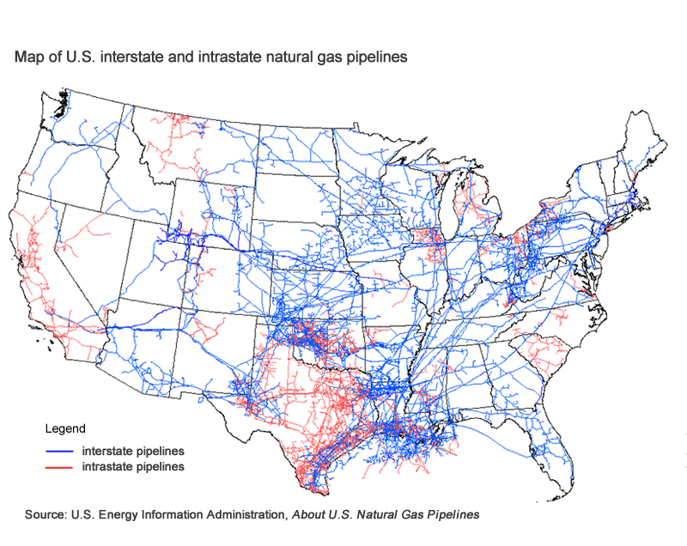
What is 49 CFR Part 192?
Overview
PART 192 is a section of the Code of Federal Regulations (CFR) that establishes the minimum federal safety standards for the transportation of natural gas and other gases through pipelines in the United States.
It is administered by the Pipeline and Hazardous Materials Safety Administration (PHMSA), a division of the U.S. Department of Transportation.
49 CFR Part 192: Transportation of Natural and Other Gas By Pipeline: Minimum Federal Safety Standards

Slide 5
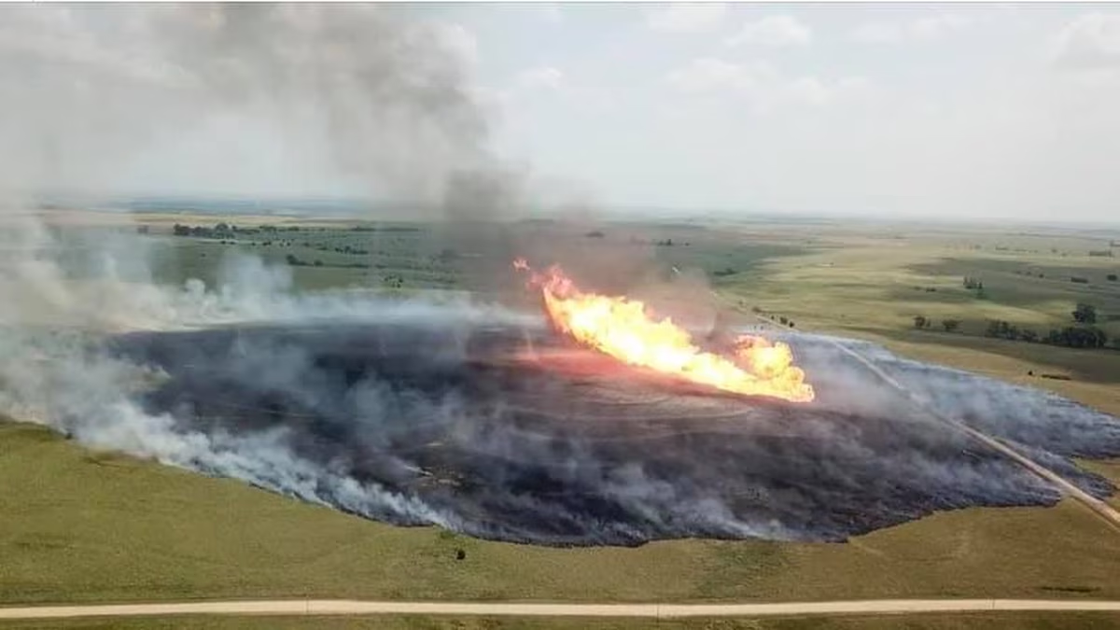
Why we should care about?
Pipeline accidents can have devastating consequences, including fatalities, injuries, property damage, and environmental harm
Prevent pipeline accidents, protecting public safety, individuals, communities, and the environment
Compliance with Part 192 guarantees that pipelines are constructed and maintained in a safe manner
Material selection and design
Component fabrication
Welding
Joining techniques
Corrosion control
Large natural gas pipeline explosion in Ellsworth County
Notes:
Part 192 serves as a crucial safeguard against pipeline accidents, protecting public safety, individuals, communities, and the environment from the potential hazards associated with natural gas pipelines.
Compliance with Part 192 guarantees that pipelines are constructed and maintained in a safe manner, encompassing all aspects from material selection and design to component fabrication, welding, joining techniques, and ongoing corrosion control measures.

Slide 6
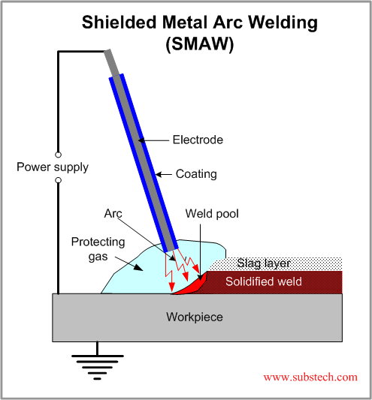
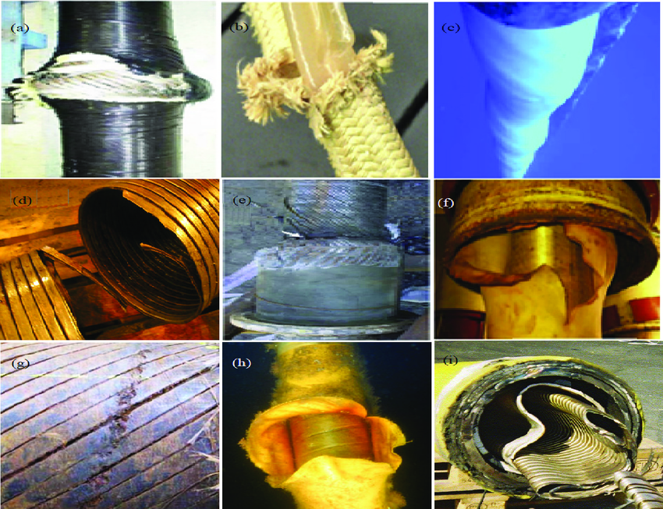
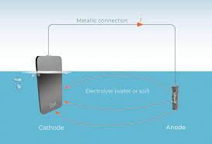
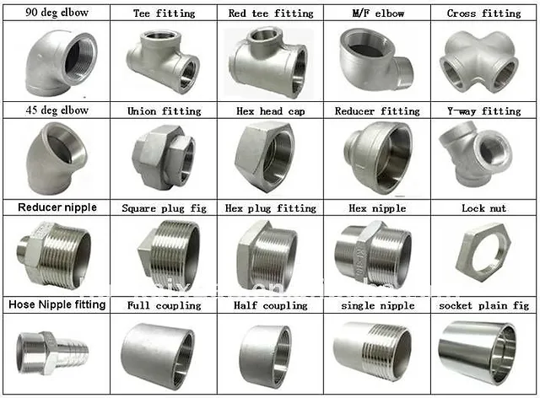
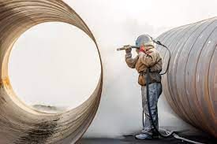

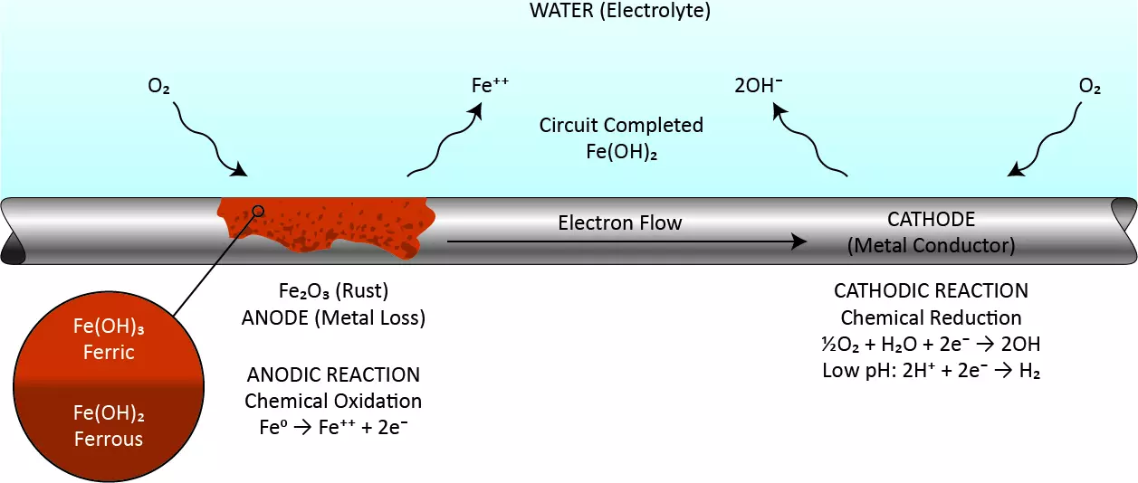
Product Application
Material selection
Welding
Corrosion Control
Cathodic Protection
Protective Coatings
Corrosion Inhibitors
Component Fabrication
Joining
Pipes Valves
Fittings Flanges
Notes:
Material Selection and Design
High-strength materials like carbon steel, stainless steel, and polyethylene are employed to withstand the pressure of transported gas and the corrosive environment.
Pipelines are designed to withstand maximum pressure, accommodate thermal expansion and contraction, and adhere to strict geometric tolerances.
Component Fabrication
Component fabrication is the process of manufacturing the components that make up a pipeline. This includes pipes, valves, fittings, and flanges. Components must be fabricated to precise tolerances to ensure a tight seal and prevent leaks.
Welding
Welding is a critical step in the construction of a pipeline. Welds must be strong and leak-proof to ensure the safety of the pipeline. Common welding techniques used for pipelines include shielded metal arc welding (SMAW), gas metal arc welding (GMAW), and flux-cored arc welding (FCAW).
Joining Techniques
There are a number of different joining techniques that can be used to connect pipeline components. These include welding, threaded joints, and flanged joints. The type of joining technique that is used depends on the specific application.
Corrosion control
Corrosion is a major threat to pipelines. Corrosion can cause leaks, which can lead to fires and explosions. There are a number of different corrosion control measures that can be used to protect pipelines, including cathodic protection, coatings, and inhibitors.

Slide 7
General Requirements (Part 192, Subpart A)
Scope: This regulation covers transportation of natural and other gases via pipelines, including both onshore and offshore pipelines.
Purpose: Its main intent is to establish minimum safety standards for pipeline facilities and the transportation of gas.
In-line inspection (ILI): an inspection of a pipeline from the interior of the pipe using an inspection tool also called intelligent or smart pigging. This definition includes tethered and self-propelled inspection tools.
In-line inspection tool or instrumented internal inspection device: means an instrumented device or vehicle that uses a non-destructive testing technique to inspect the pipeline from the inside in order to identify and characterize flaws to analyze pipeline integrity; also known as an intelligent or smart pig.

Slide 8
Materials (Part 192, Subpart B)
Purpose: This subpart prescribes minimum requirements for the selection and qualification of pipe and components for use in pipelines.
General: Materials for pipe and components must be:
(a) Able to maintain the structural integrity of the pipeline under temperature and other environmental conditions that may be anticipated;
(b) Chemically compatible with any gas that they transport and with any other material in the pipeline with which they are in contact; and
(c) Qualified in accordance with the applicable requirements of this subpart.
Steel Pipe: Steel pipes must comply with specific requirements related to their manufacturing process and must be suitable for the type and level of the stress they'd experience.
Plastic Pipe: For plastic pipes, there are stipulations regarding their construction and quality.

Slide 9
Design of Pipeline Components (Part 192, Subpart D)
Purpose: This subpart prescribes minimum requirements for the design and installation of pipeline components and facilities. In addition, it prescribes requirements relating to protection against accidental overpressuring.
General requirements:
Each component of a pipeline must be able to withstand operating pressures and other anticipated loadings without impairment of its serviceability.
Each new transmission line and each replacement of line pipe, valve, fitting, or other line component in a transmission line, must be designed and constructed to accommodate the passage of instrumented internal inspection devices in accordance with NACE SP0102, section 7.

Slide 10
Requirements for Corrosion Control (Part 192, Subpart I)
Purpose: This subpart will detail the requirements to minimize the corrosion of metal pipelines and components.
External Corrosion Control: Details methods to control external corrosion, like cathodic protection, protective coating, and other techniques.
Internal Corrosion Control: Describes methods to control internal corrosion, like chemical treatments, cleaning pigs, or other measures.
Monitoring: Requires periodic inspection and tests to ensure that corrosion control measures are effective.

Slide 11
Test Requirements (Part 192, Subpart J)
Purpose: Prescribes the minimum leak-test and strength-test requirements for pipelines.
General: Before operating a new or relocated pipeline segment:
It must be tested to confirm the maximum allowable operating pressure.
All potentially hazardous leaks should be eliminated.
Environmental protection and safety requirements:
When testing, operators must ensure the safety of their employees and the public. If the hoop stress exceeds 50% of SMYS during the test, operators should restrict public access to the test area. They must also ensure the test medium is disposed of in an environmentally-friendly manner.

Slide 12
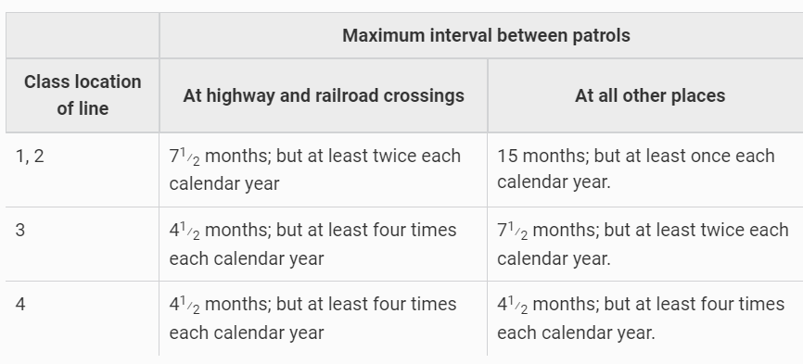
Maintenance (Part 192, Subpart M)
General: (a) Each operator shall have a patrol program to observe surface conditions on and adjacent to the transmission line right-of-way for indications of leaks, construction activity, and other factors affecting safety and operation.
(b) The frequency of patrols is determined by the size of the line, the operating pressures, the class location, terrain, weather, and other relevant factors, but intervals between patrols may not be longer than prescribed in the following table:

Slide 13
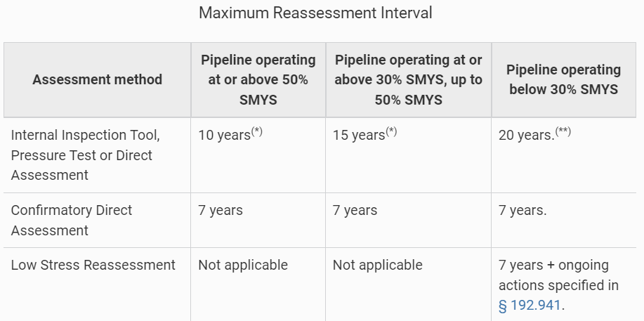
Gas Transmission Pipeline Integrity Management
(Part 192, Subpart O)
Purpose: Requirements for pipeline assessment.
General: An operator must assess the integrity of the line pipe in each covered segment by applying one or more of the following methods for each threat to which the covered segment is susceptible. An operator must select the method or methods best suited to address the threats identified to the covered segment.
Pipelines must be reassessed at regular intervals, typically every seven years.

Slide 14
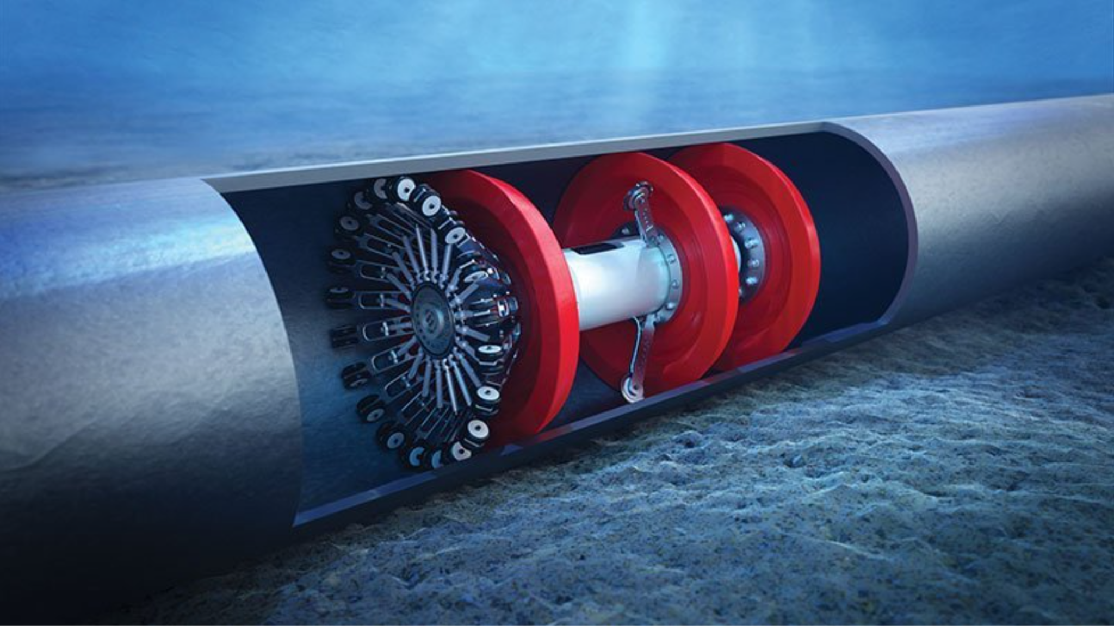
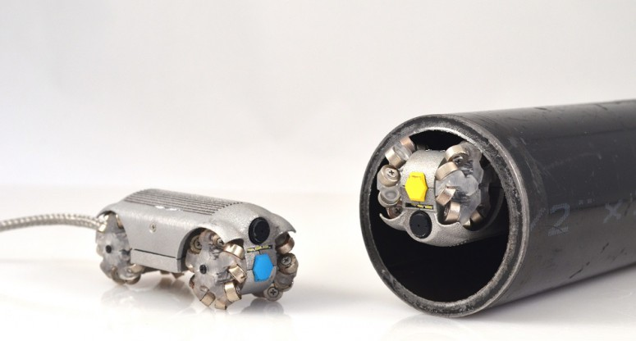
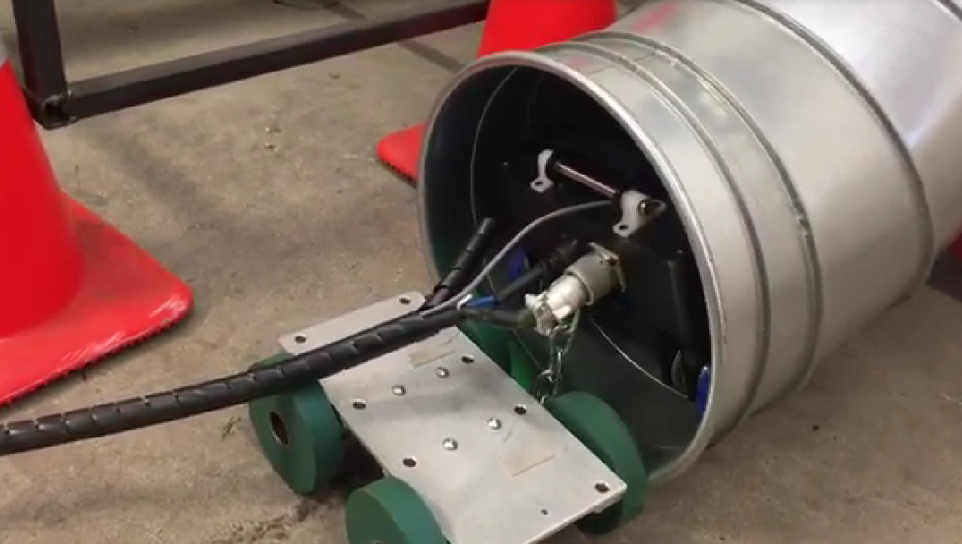
How does it apply to our RoboSpect?
Pipe construction must allow in-pipe inspection devices (subpart A, J, and L)
Inspection defined in section A:
In-line inspection (ILI): means an inspection of a pipeline from the interior of the pipe using an inspection tool also called intelligent or smart pigging. This definition includes tethered and self-propelled inspection tools.
In-line inspection tool or instrumented internal inspection device: means an instrumented device or vehicle that uses a non-destructive testing technique to inspect the pipeline from the inside in order to identify and characterize flaws to analyze pipeline integrity.
Our robot is capable and needed to perform in-pipe inspection for any natural gas pipeline
Robot design should follow safety regulations, such as the tethered system

Slide 15
How does it apply to our RoboSpect?
Regular pipe inspection is required by 192.14 and following subparts
The design, construction, operation, and maintenance history of the pipeline must be reviewed and, where sufficient historical records are not available, appropriate tests must be performed to determine if the pipeline is in a satisfactory condition for safe operation.
Their are great needs for pipe inspection in this country: we have market!

Slide 16
How does it apply to our RoboSpect?
Pipe repair material is required in subpart B
Minimum criteria for selecting and qualifying materials for pipeline components, ensuring they maintain structural integrity, are chemically compatible with transported gases and pipeline materials, and meet the subpart's requirements.
Unknown environment obstacle detection
Detail inspection and defects prediction
Inpipe repair
our project
ultimate goal
These requirements are not directly related to our project, but relevant to ARPA-E repairing side

Slide 17
Regulation 2
ANSI/RIA R15.08.2020 (Industrial Mobile Robots Safety Requirements)
Sections 4, 5.1, 5.3, and 7.4

Slide 18
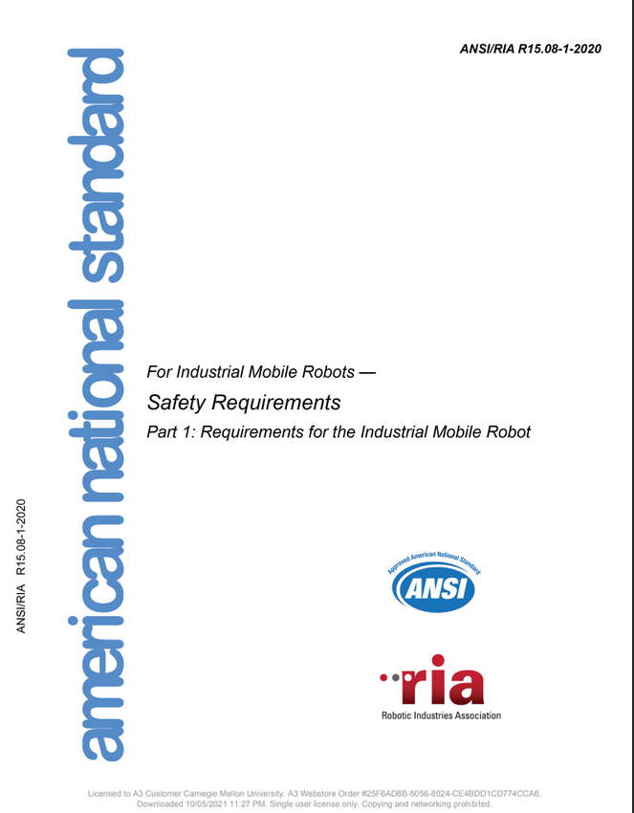
Summary
The “objective is to specify safety requirements for industrial mobile robots (IMRs)”
“describes basic hazards associated with IMRs… and provides requirements to eliminate, or adequately reduce, the risks associated with these hazards”
Section 4: Hazard identification and risk assessment
Section 5: Design requirements and risk reduction measures
Split with Team H
Section 5.1: General requirements for IMRs and attachments
Section 5.3: Specific requirements for autonomous mobile robots (IMR Type A)
Section 7.4: Description of the specified operating environment

Slide 19
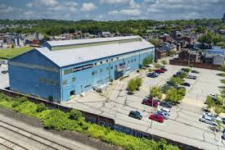
Scope - What is an IMR?
Industrial Mobile Robot = “Mobile platform capable of navigating through an industrial environment to reach a specified location”
Mobile Platform = “assembly of all components of the mobile robot that enables self-propelled movement”
Industrial environment = “workplace where the public is restricted from access or not reasonably expected to be present for the intended tasks and robot applications”
Navigation may be autonomous or guided
Includes robots with or without attachments/manipulators
Includes robots operating alone or in a fleet
Affected Markets:
Delivery/Logistics/Warehousing Robots
Agriculture
Defense
Healthcare/Pharmaceutical
Inspection Robots
Notes:
IMRs are defined by the regulation as robots capable of navigating through the environment to reach a specified location, and said navigation may be based on onboard autonomy, or in some cases defined by a pre-established guidepath.

Slide 20
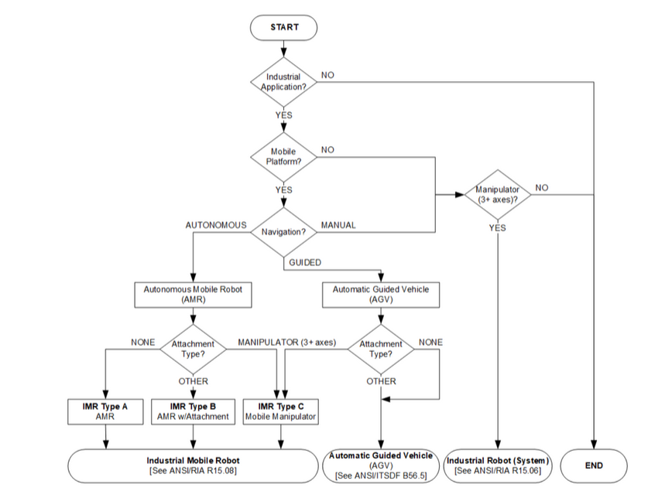
Why Type A?
Notes:
IMR Type A is an IMR without any attachments, while IMR type B and C have attachments or manipulators. Our pipe explorer robot, since it has no attachments for its environment when used as designed, is a Type A (the illumination ring can be removed, but that would severely compromise the functionality of the system).

Slide 21
Section 4: Hazard Identification and Risk Assessment
Provides a framework for identifying and assessing the hazards and risks associated with IMRs in an industrial environment.
Main Prescriptions:
Identify all hazards associated with the IMR.
Assess the risks associated with each hazard.
Implement risk control measures.
Verify and validate the risk control measures.
Document the process.

Slide 22

Section 4: Hazard Identification and Risk Assessment
Section 4 provides a framework for assessing hazards & risks associated with IMRs in an industrial environment.
Identify all hazards associated with the IMR.
Assess the risks associated with each hazard.
Implement risk control measures.
Verify and validate the risk control measures.
Document the process.
Some specific examples of hazards that may be associated with RoboSpect’s autonomous pipe inspection robots include:
Collision hazards with other objects in the pipeline or narrow sections of pipeline
Electrical/Fire hazards from the robot's batteries or other electrical components
Explosion hazards if the robot encounters a flammable gas in the pipeline
Risk control measures:
Designing the robot to be as small and streamlined as possible to reduce the risk of collision
Insulating the robot's electrical components to prevent electrical hazards
Developing procedures for safely operating and maintaining the robot
Notes:
For example, the risk of collision hazard is likely to be high if the robot is operating in a pipeline with a lot of other objects, such as valves and bends. However, the risk of explosion hazard is likely to be low if the pipeline is properly ventilated and the robot is designed to detect and avoid flammable gases.

Slide 23
Section 5.1: General requirements for IMRs and attachments
Operating Mode options
Automatic Mode
Activates with a press button command
Semi-Automatic Mode
Continuous operator activation required for the functions of the IMR under operator control
Manual Mode
Required when IMR operations are under the control of a portable control unit.
Maintenance Mode
Comms Interface
Should relate safety-related info, including:
Enabled state of the IMR,
Location and Identify of detected objects
Raw sensor feedback from onboard presence-sensing devices
changes to the pos/traj of the IMR from obstacle avoidance and collision avoidance.
If wireless, protective stop when signals are not received, including loss/delay in communication
Notes:
These requirements apply to all IMRs, including Type A IMRs, which are the most generic type of IMR. Automatic mode: IMR shall execute the task program and risk reduction measures shall be functioning. Motion prevented if stop condition detected. Switching from this shall result in a controlled stop. Press button and go automatic mode
Semi-automatic mode: continuous operation activation shall be required for the functions of the IMR under operator control
Manual Mode: continuous operator activation of an IMR enabling device shall be required when IMR operations are under the control of a portable control unit, which is used to operate using a single point of control. . Safety devices required for automatic or semi-automatic operation may be bypassed -- operator is in direct control of the IMR. Maintenance Mode: just should not generate hazardous situations There should also be a comms interface, which isn’t required but recommended, and it should relay the information listed. Also, if the comms are wireless, a protective stop needs to be performed when signals are not received

Slide 24
Section 5.1: General requirements for IMRs and attachments
Control Functions
Restart functions: can automatically restart after protective stops (assuming no obstacles)
E-stop functions: should be provided but not required when it would not lessen risk
Protective stop: 1+ needed to stop IMR within span-of-control (REQUIRED)
Nav & Control
Collision avoidance (REQUIRED)
Stops IMR or reduces severity of a collision when contract can't be avoided
Velocity limiting (REQUIRED)
IMR can limit velocity to reduce tip-over hazard
Settings need to be configurable by authorized individuals
0.3 m/s velocity limit for safety functions (no obstacle detection, in restricted area)
When “presence-sensing devices” used, presence of detectable obstacles in working space should result in a working stop
Notes:
If presence-sending funcs can be bypassed in open areas, a safety func that limits the velocity to at most 0.3 m/s must be provided
Safety distances should be provided in the information for use, use worst-case distances

Slide 25
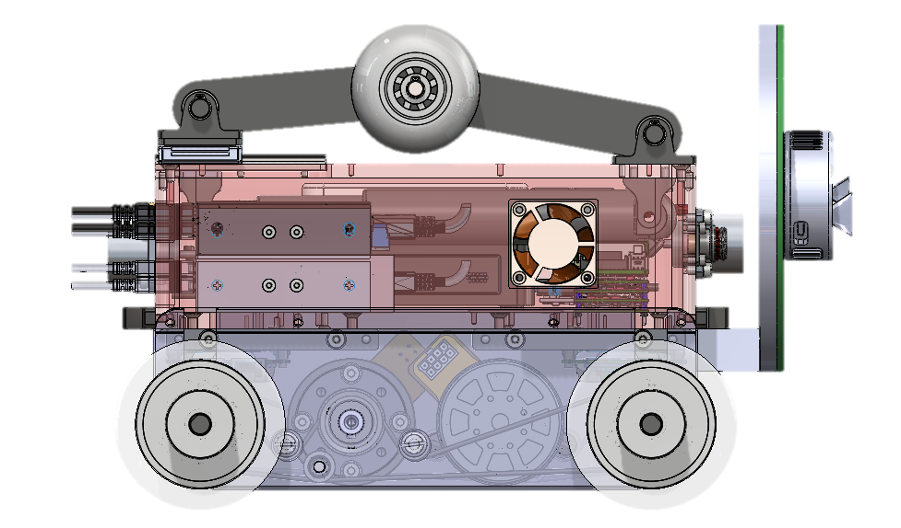
Section 5.3: Specific requirements for IMR Type A
Type A IMRs mostly adhere to the general requirements
Differences:
Stability and Center of Mass data must be provided in the information to use
Additional specifications required if the IMR supports attachments at times (volume where payload can be located, how to maintain stability, etc.)
Presence-sensing devices
Need to be configurable for safety and prevent hazardous contact at some level
If non-configurable, shall provide information for use based on the capabilities and limitations of the presence-sensing devices
Notes:
mobile platforms shall either have configed safety-related params of the presence-sensing device to prevent hazards, OR be capable of configuring safety-related params of the presence-sensing device to prevent hazards. IMRs without configurable safety-related params shall provide info for use based on capabilties and limits

Slide 26
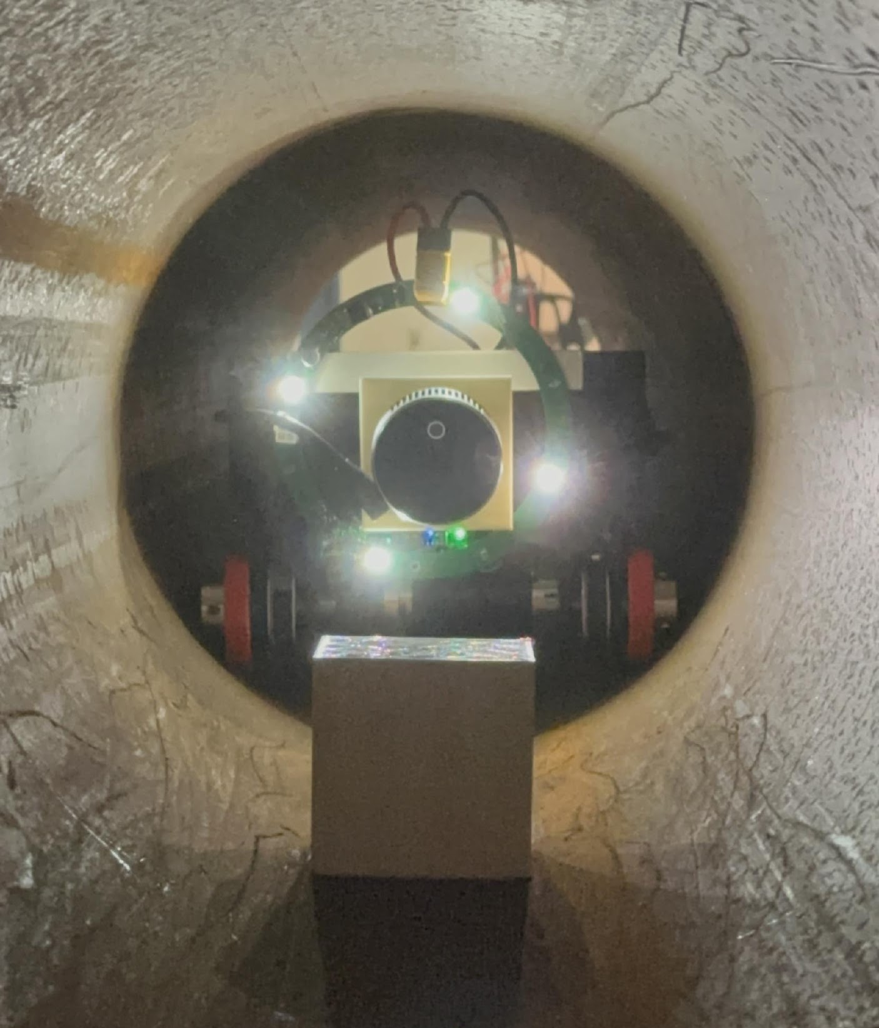
Section 5: Application to RoboSpect
Confirmed that wired comms interface is listing all required information
Naturally within prescribed velocity limit of the velocity limiting standards
Meeting working/protective stop functionality for collision avoidance and safety already
L515 LiDAR counts as “presence-sensing device”, meet those requirements
No hard standards on stopping distance, but lists factors we should consider before sticking to any given stop distance

Slide 27
Section 7.4: Description of the specified operating environment
Section 7.4 manufacturers of IMRs to provide a description of the specified operating environment in which the IMR is intended to be used. The description of the specified operating environment must include the following information:
The physical environment in which the IMR will be used, including the following factors:
Temperature range
Humidity range
Vibration levels
Dust and debris levels
Chemical exposure
The operational environment in which the IMR will be used, including the following factors:
Types of tasks to be performed
Materials to be handled
Interaction with other equipment and humans
The safety requirements for the IMR in the specified operating environment, including the following factors:
Collision avoidance requirements
Emergency stop requirements
Operator controls requirements
Warning signals requirements

Slide 28
Section 7.4: Application to RoboSpect
To follow ANSI/RIA R15.08, RoboSpect should develop a description of the specified operating environment that includes that information about the physical environment, operational environment and safety requirements.
Some specific examples include:
Temperature range: full range of temperatures that the robot may be exposed to
Dust and debris: designed to operate in dusty and dirty environments
Hazardous chemicals: designed to operate safely and protect operators from exposure
Collision avoidance: equipped with necessary sensors and software
Emergency stop: appropriate emergency stop mechanisms
Operator controls: easy-to-use
Warning signals: appropriate audible and visual signals

Slide 29
Thank you for your time!
Questions?

